Slide 1
14th Workshop on Software Engineering Education
and Reverse Engineering
Sinaia, Romania, August 24 - 30, 2014
Programming Concepts
in GPU Computing
Dušan B. Gajić
CIITLab, Dept. of Computer Science
Faculty of Electronic Engineering
University of Niš, Serbia

Slide 2
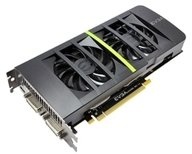
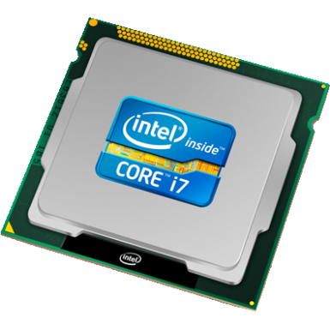
Presentation Outline
Graphics processing units (GPUs)
GPU computing and its applications
GPU architecture and programming
Case study
5. Conclusions

Slide 3
Graphics Processing Unit (GPU)
The first GPU appeared in 1999
Graphics processing unit (GPU) is a
hardware device originally specialized
for rendering computer graphics
Early 2000s: fixed-function processors dedicated to
rendering computer graphics
Modern GPUs: unified programmable graphics processors
and parallel computing platforms
GPU design philosophy is oposite to the design of CPUs (throughput vs latency)
in 2003 Moore’s law hit a wall
different programming philosophy

Slide 4
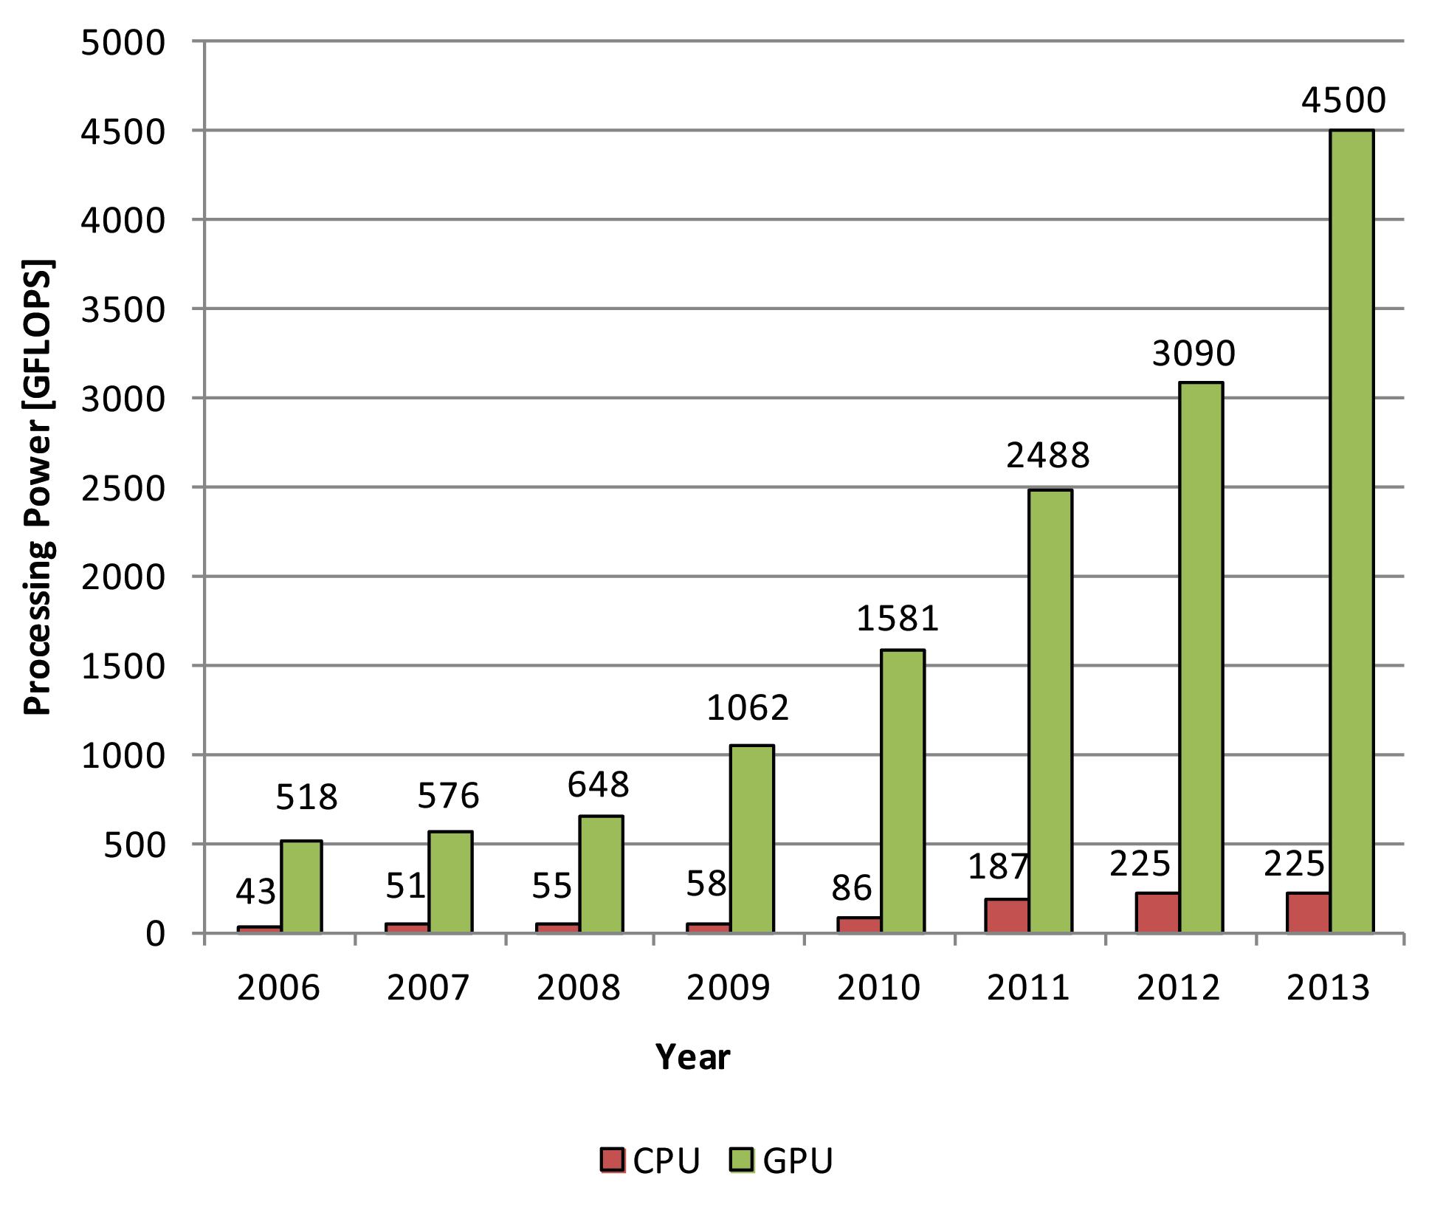
CPU and GPU Processing Power 2006-2013

Slide 5
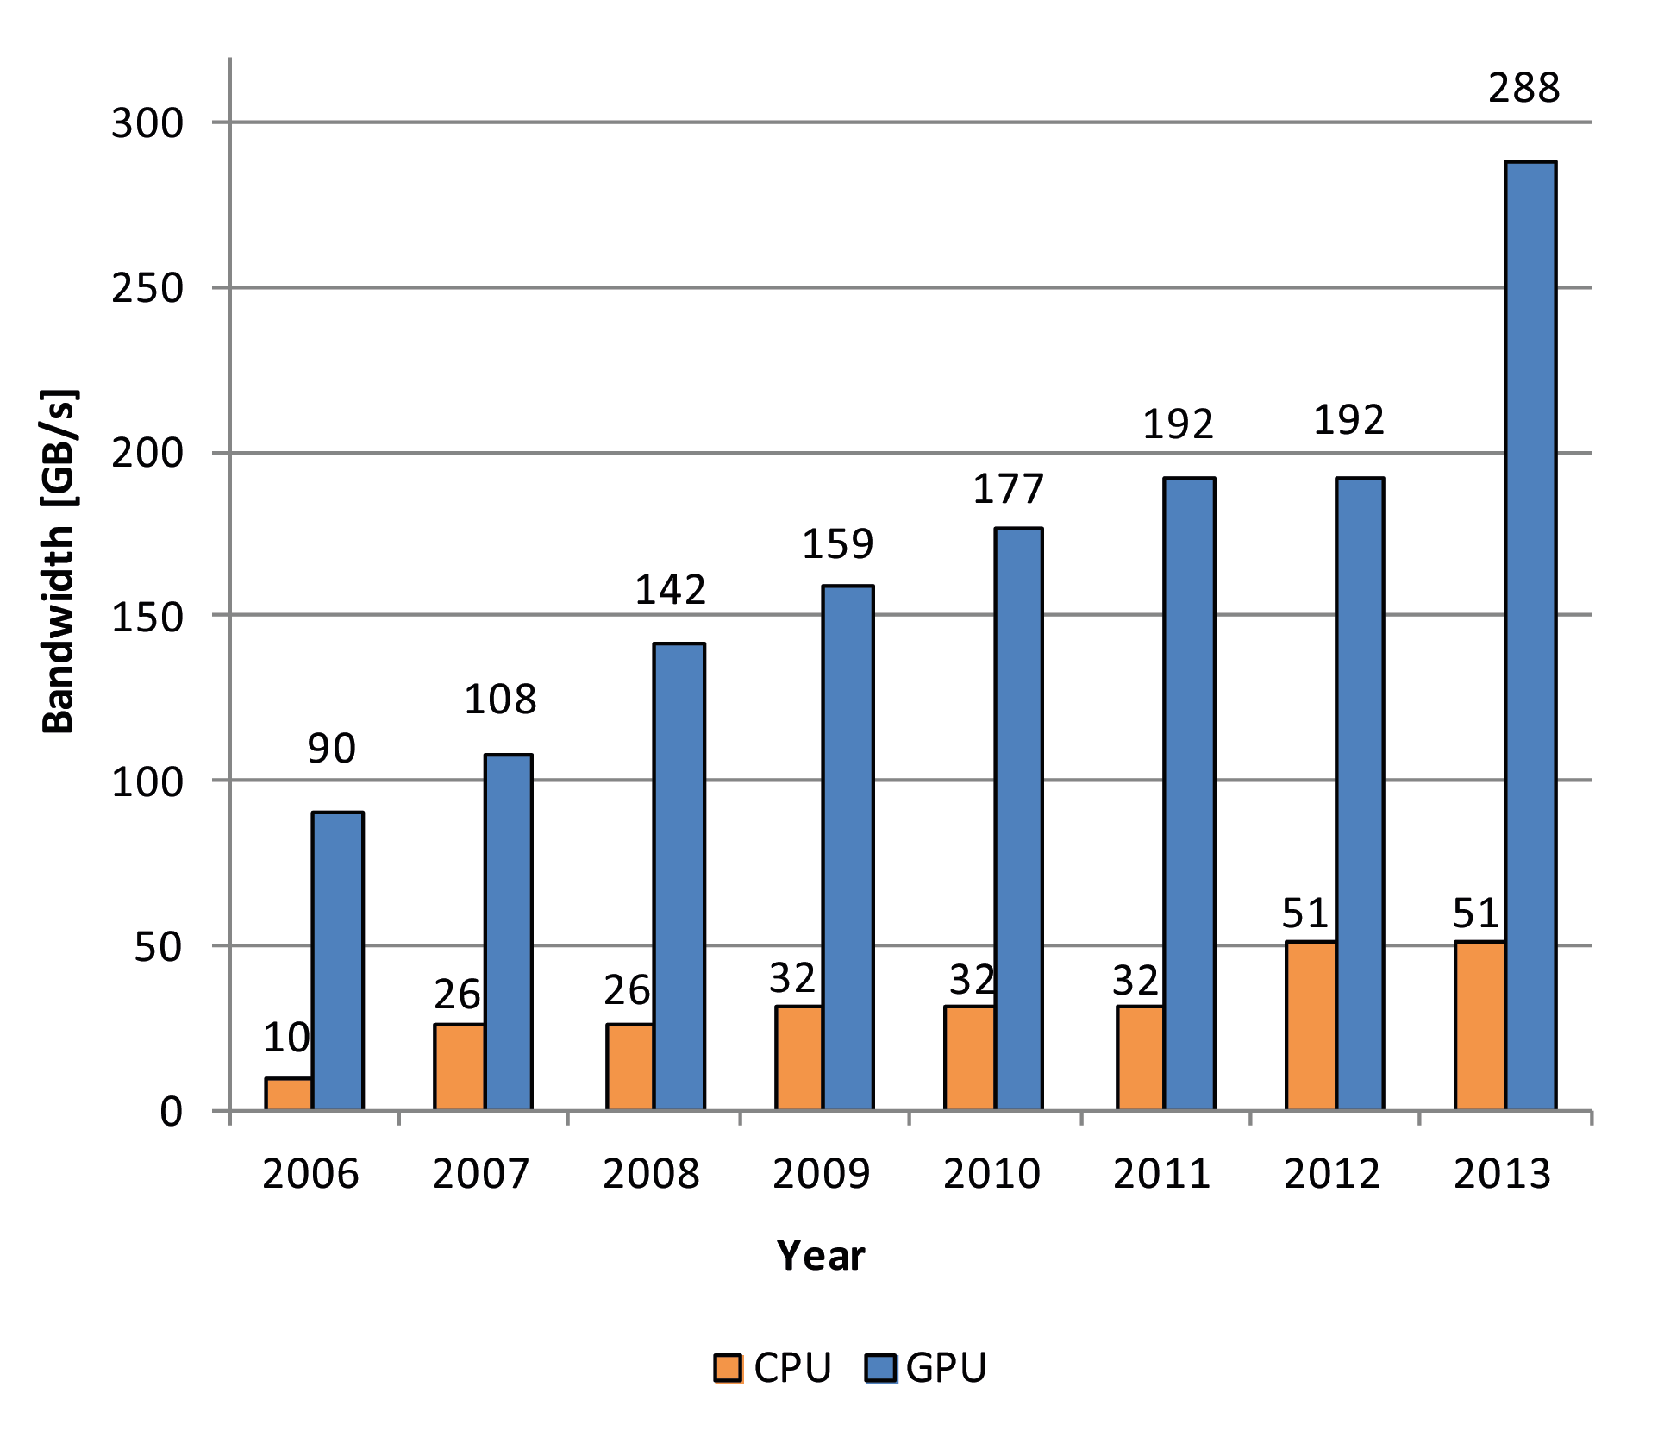
CPU and GPU Memory Bandwidth 2006-2013

Slide 6
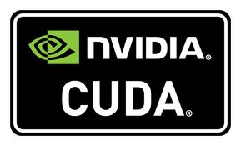
GPU Computing
General purpose computations on the GPU
(GPU computing) – developed from GPGPU
GPU features:
SIMD manycore architecture
high throughput and processing power
less cost and lower energy consumption
Suitable for intensive computations and large data processing
Nvidia CUDA (high performance, exclusive for Nvidia GPUs),
appeared in 2007
OpenCL (open standard, acceleration on heterogeneous
devices (CPUs, GPUs, DSPs, FPGAs), appeared in 2009

Slide 7
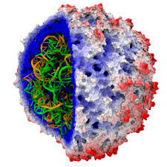
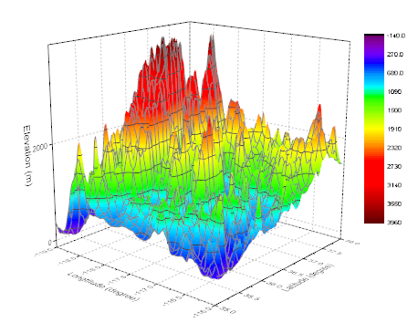
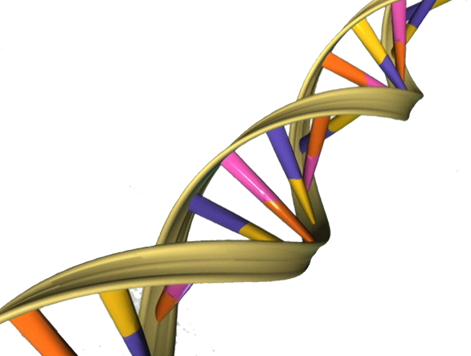
GPU Computing Applications
Machine Learning and Computer Vision
Digital Signal Processing
Bioinformatics
Medical Imaging
Augmented Reality
Meteorology
Astronomy
Computational Finance

Slide 8
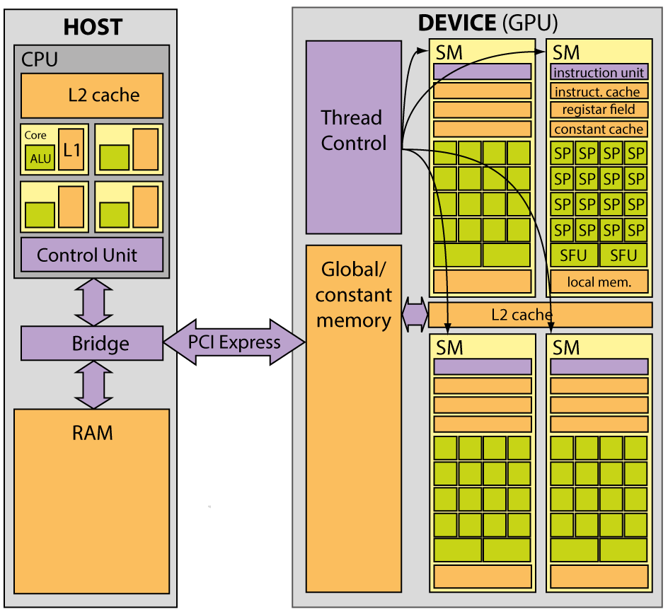
GPU Architecture and Computing Model
2
3
GPU executes kernels with high parallelism
Novel programming approach to GPUs
1
input
input
buffer
output
output
buffer
4

Slide 9
GPU Programming Abstractions
A GPU computing program is composed of:
host program (on CPUs, sequential, controls execution)
device program (on GPUs, massively parallel, implements kernels)
Kernel is a data-parallel function executed on a GPU
Each kernel describes computations performed by a single thread
Block (set of threads) and grid (set of blocks)
configuration defined by the host
Branching is expensive, data and task parallelism, ...
Different choice of algorithms, e.g., heapsort and mergesort

Slide 10
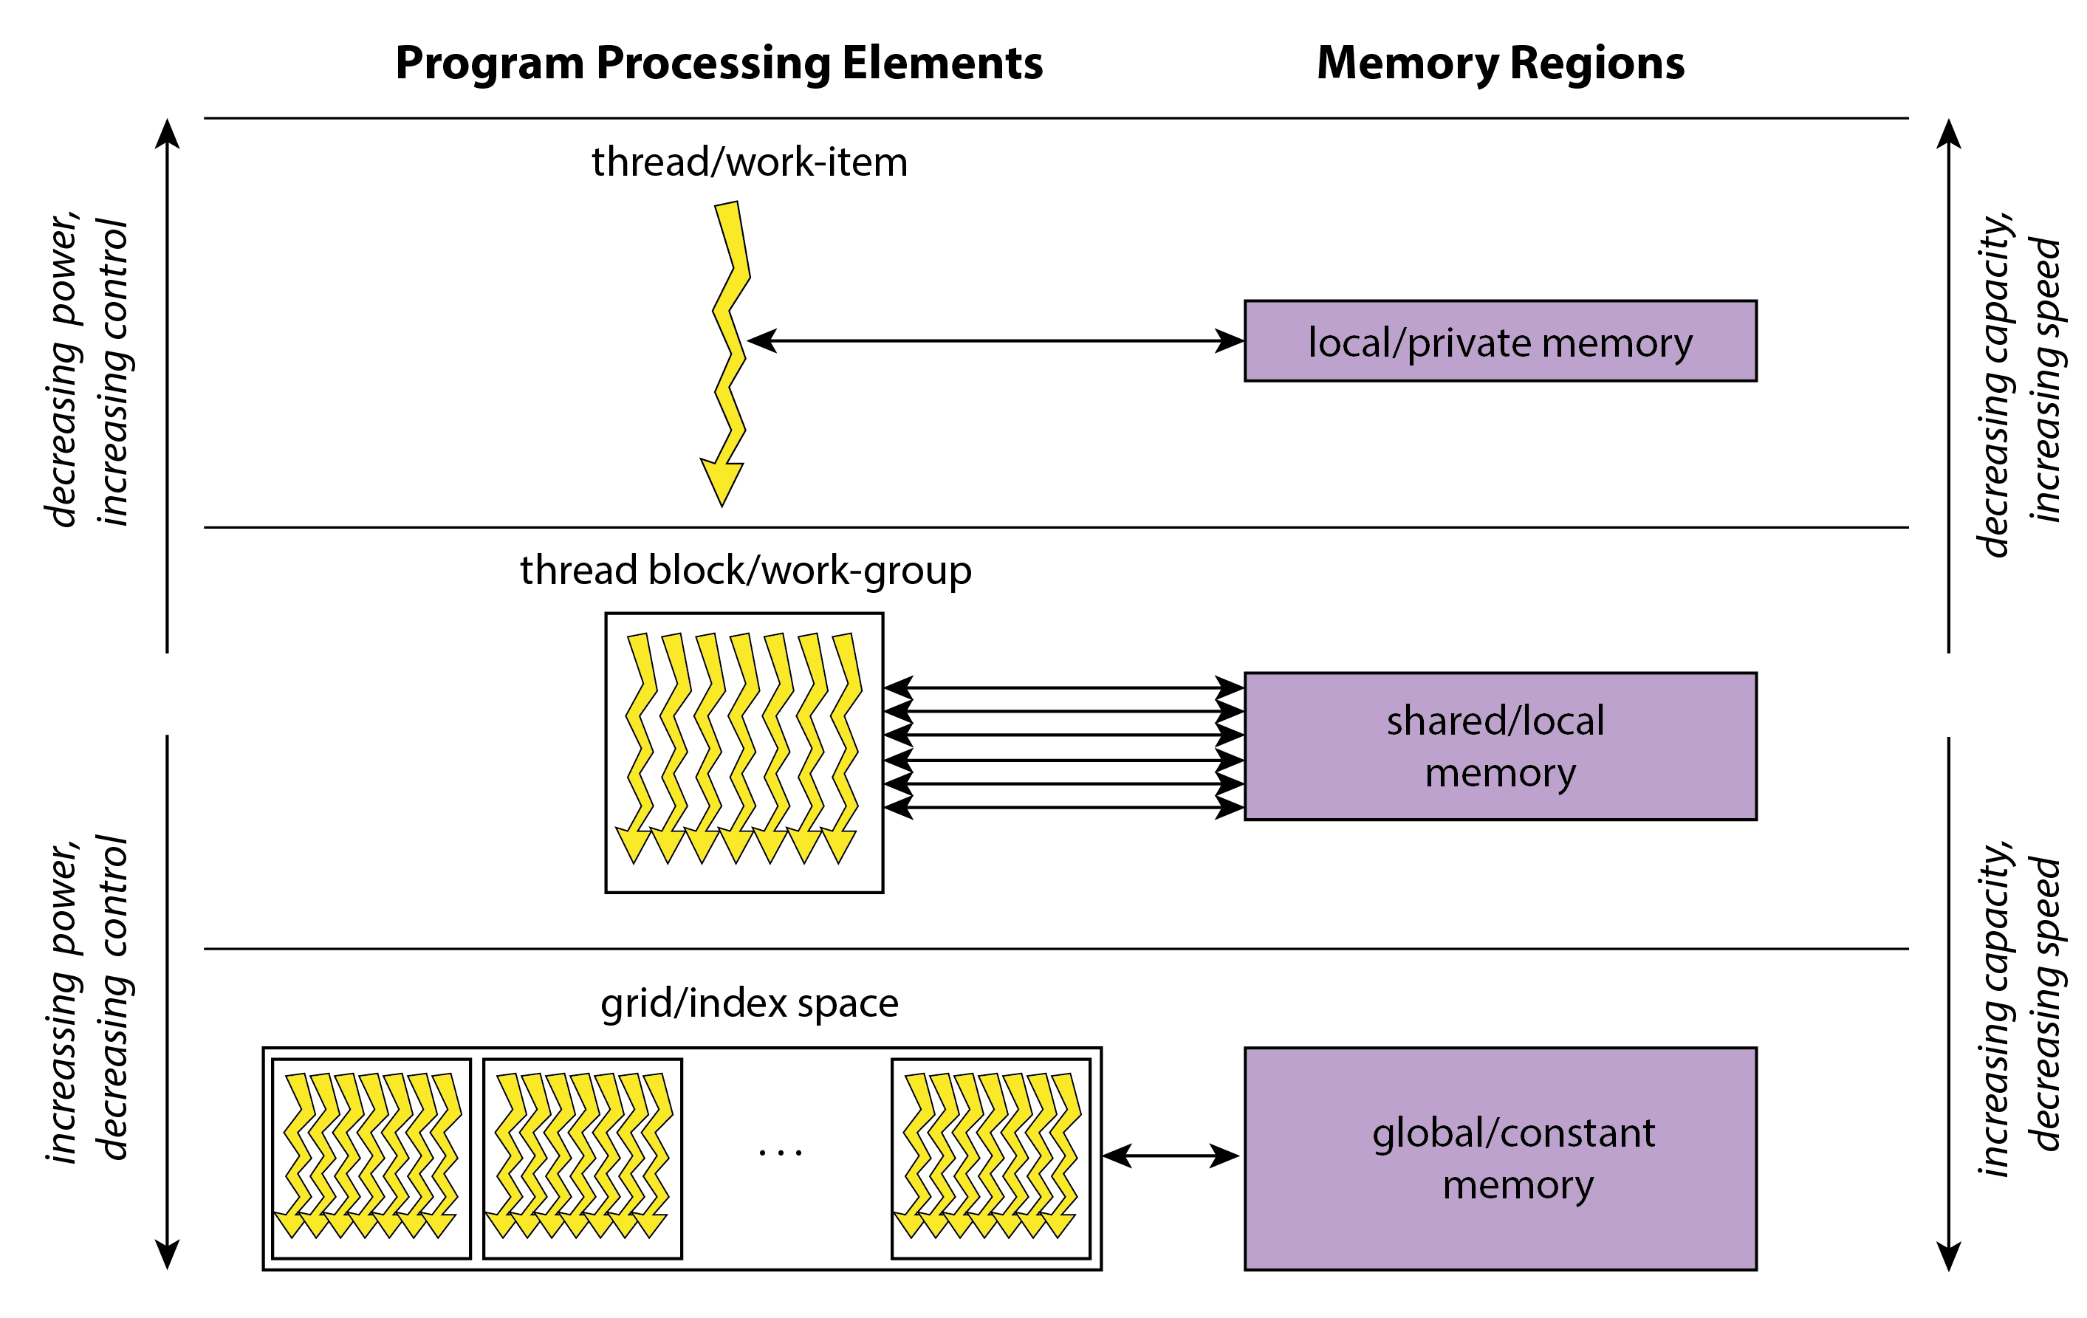
GPU Programming Abstractions

Slide 11
Case Study – Modulo p Addition
Randomly generated p-valued logic function vectors F(n)
Computed component-wise vector addition
Y(n) = F(n) ⊕ F(n) , ⊕ - modulo p
The operator ⊕ was implemented on CPUs and GPUs using:
1. look-up tables (LUTs)
2. modulo arithmetic operator % from C++ and CUDA

Slide 12
Case Study – Addition Modulo 3
n | Processing time [ms]
 | C++ |  | CUDA
 | LUT | MOD | LUT | MOD
p = 3
15 | 17 | 25 | 6 | 1.9
16 | 49 | 76 | 18 | 5.5
17 | 149 | 229 | 55 | 16
Better GPU implementation approx. 10 × faster
than the better CPU implementation
LUTs faster than MOD on CPUs,
the opposite case on GPUs

Slide 13
Case Study – Performance on CPUs
p not a power of 2 - LUTs faster than MOD , from 1.5× to 2.05×
p a power of 2 - MOD as fast as LUTs due to bitwise ops

Slide 14
Case Study – Performance on GPUs
In all cases - MOD faster than LUTs, from 3.3× to 19.5×
As p increases, advantage of using MOD over LUTs increases

Slide 15
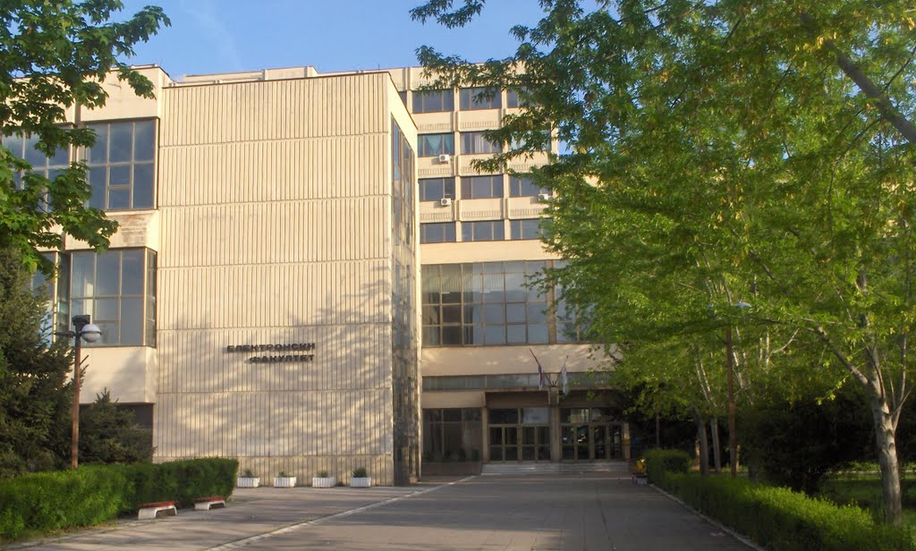
GPU Computing at the FEE Niš
Founded in 1960, part of University of Niš with 30.000 students
Research on performing spectral methods on GPUs
(Fourier and related transforms, matrix computations, ...)
GPU computing used in courses:
Digital Signal Processing – 4th year
Pattern Recognition – 4th year
Spectral Methods – 5th year
Challenge for students:
Making a shift in thinking from
traditional CPU programming

Slide 16
Conclusions
Modern GPUs are unified programmable graphics processors
and parallel computing platforms
GPUs - SIMD parallel architecture and
massively-parallel programming model
Case study – contrasting programming techniques
for achieving high performance on CPUs and GPUs
Better preparation for parallel computing is necessary
in programming and algorithm courses
Heterogenous parallel processing is both
the present and the future of high-performance computing
(at least until we have something better ☺)

Slide 17
14th Workshop on Software Engineering Education
and Reverse Engineering
Sinaia, Romania, August 24 - 30, 2014
Programming Concepts
in GPU Computing
Dušan B. Gajić
CIITLab, Dept. of Computer Science
Faculty of Electronic Engineering
University of Niš, Serbia

